Slide 1
Introduction to SplashBI (201 Training)

Slide 2
This will attempt to give you, the end-user, an idea of some of the features and functionality of the SplashBI product.
You will see enough of the basic things to enable you to start using the product after viewing this introduction.

Slide 3
What we are going to do….
SplashBI – What is it? Why use it?
Go over concepts & key terminology of the SplashBI product.
Build and edit several reports utilizing some different features of SplashBI.
Go over additional features of SplashBI.

Slide 4
A little about SplashBI
It is a “browser” based tool and can be used with all types of browsers (Internet Explorer, Edge, Firefox, Chrome, etc.)
To utilize all the tools of SplashBI please set your browser’s zoom level to 100% and limit anything that would hinder you from a full screen view.
Requires some familiarity with the CDP applications (Environmental, Patient Services, etc.)
There is no need for an in-depth knowledge of SplashBI.
Allows end-users to create, store, share and edit reports.

Slide 5
Why use SplashBI
To do ad-hoc queries in lieu of running or looking through reports. Some examples could be:
How many surveys were completed in a given date range?
How many surveys were finalized vs submitted?
Generate a listing of all establishments for a service unit by establishment type.
Generate a listing of all activities conducted in a given date range for a selected Community.
What was the attendance for a training provided on site?

Slide 6
Key Terminology
Domain
This identifies where the data you will have access to resides. You should only see Indian Health Services – IHS Environmental
Tables
Store details about groups of related information (Establishments, surveys, etc.)
Usually relates to a database table or view
Items
Folders contain items (for example the “surveys” folder might contain State ID, Premise name, Score, etc.)
Usually relates to a column in a database table
Reports
Stored on the database
Can be exported to various other applications

Slide 7
The reports we will build will be based on the North Carolina Environmental business area on the SplashBI test server.
It is important to understand the CONCEPTS of how we are using SplashBI as opposed to the system or business area we are using.
The URL for the SplashBI production server is provided at the end of the PowerPoint.

Slide 8
REPORT #1
We will:
Connect & sign on to SplashBI
Build a simple report
Apply some “user defined” filters
View the report
Edit the report
Format table layout
Add a sort
Edit existing filters
Rename the report
Submit the report
Open the report in Excel
Save and close the report

Slide 9
Connecting to SplashBI
Launch preferred browser (we recommend Chrome).
Type in the following URL for this training:
https://splashbi.cdpehs.com/SplashBI/en_US/Login.html
After typing in the SplashBI URL you should be brought to the Login page.

Slide 10
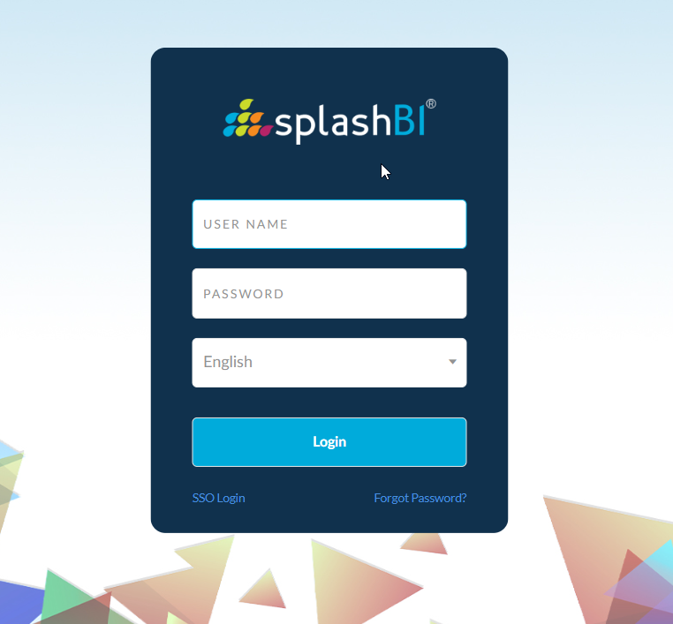

Slide 11
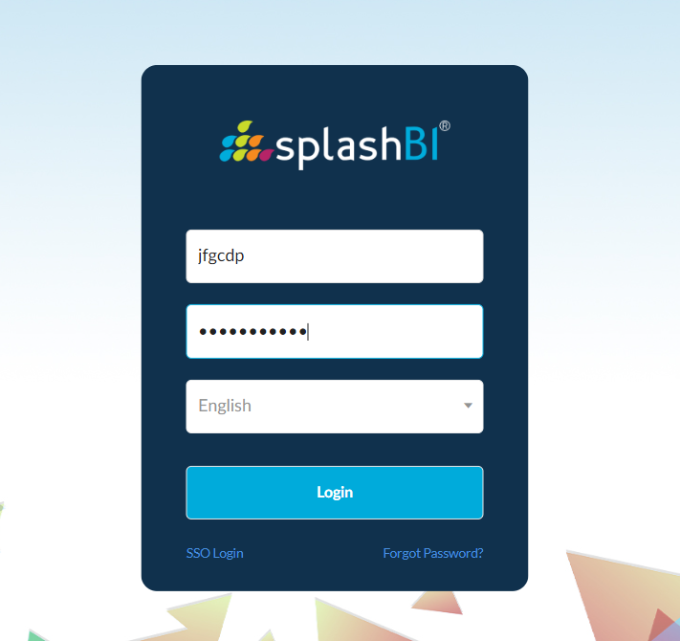
Enter Username = User-name given to you by CDP Password = Password given to you by CDP

Slide 12
Home Screen
From the home screen you can
See all reports
Create new reports
Go to your favorite reports
Get to your generated report
Modify your user profile
Change your settings
Access the help section
Log out
Change the layout of your home screen

Slide 13
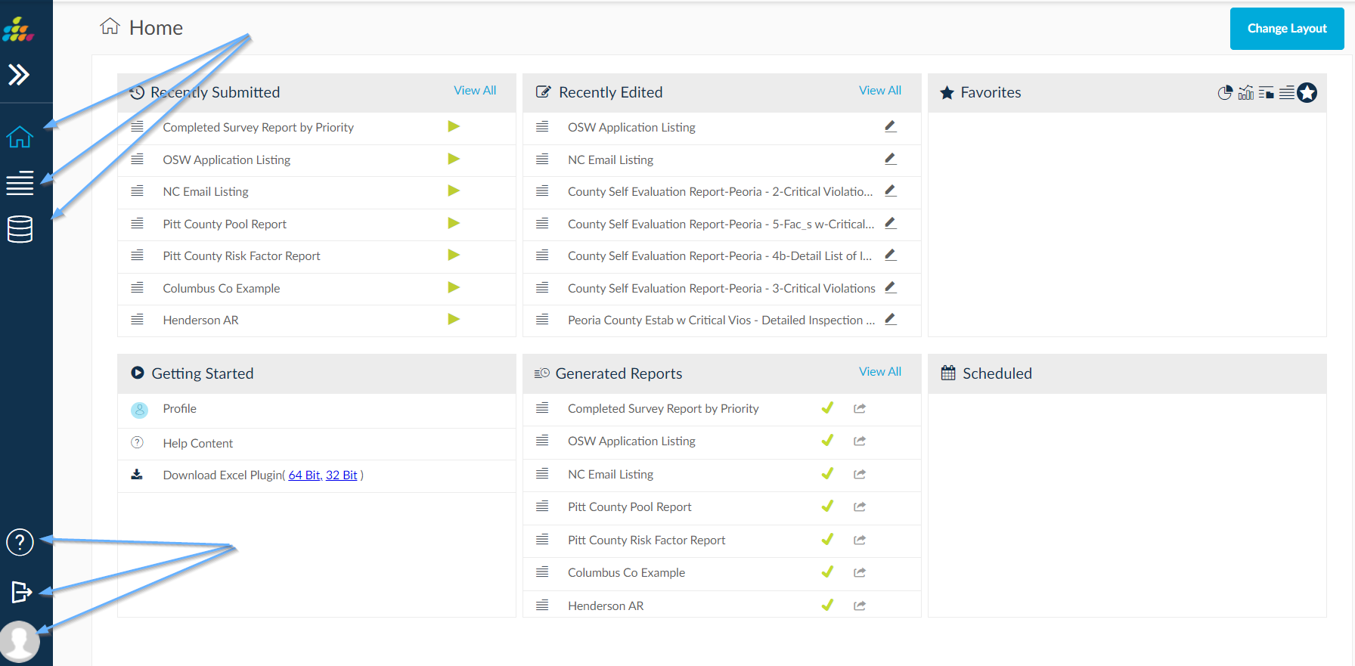
See all, create new, favorites and generated reports… User profile, settings, help and log out… Change layout…

Slide 14
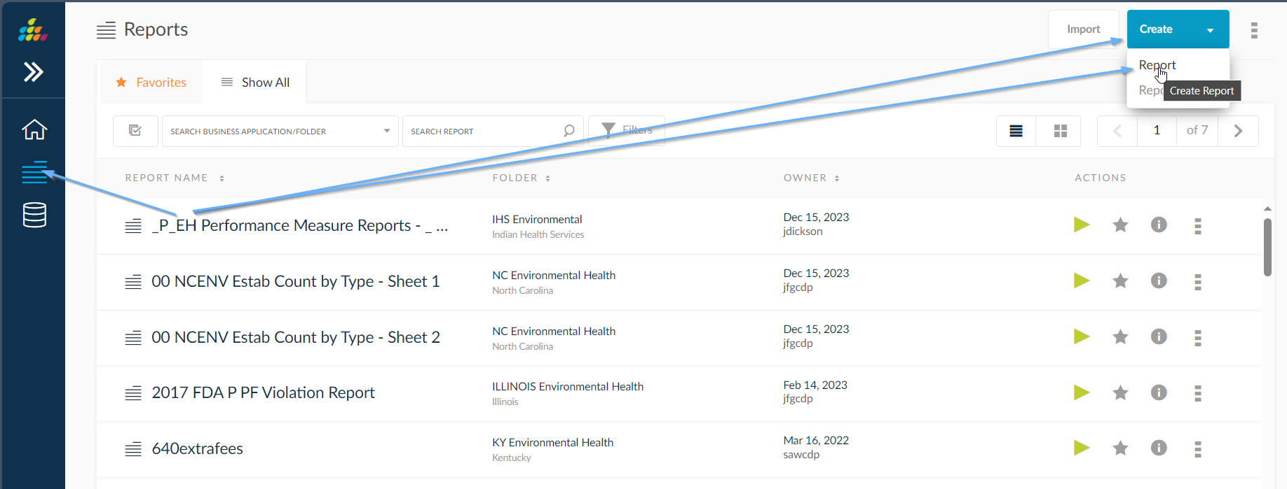
Click on “Create Report”. We will open an existing report later in this session.

Slide 15
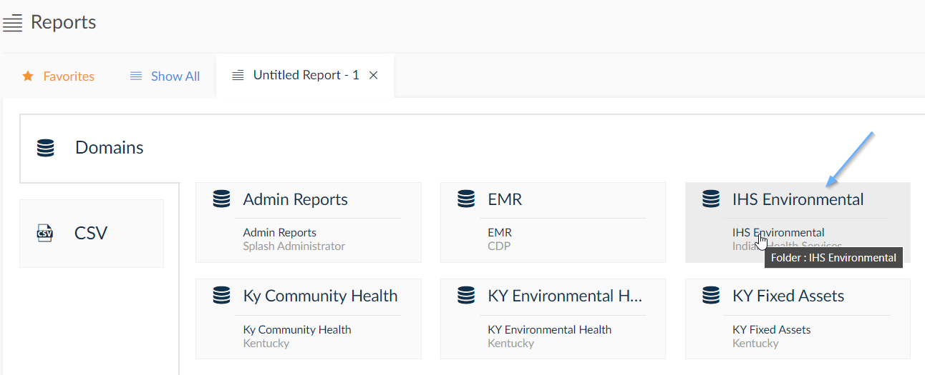
You will next select the domain that contains the information that you want to use. You will only see the domains that you are authorized to see (IHS Environmental). You will only see the data that belongs to you.

Slide 16
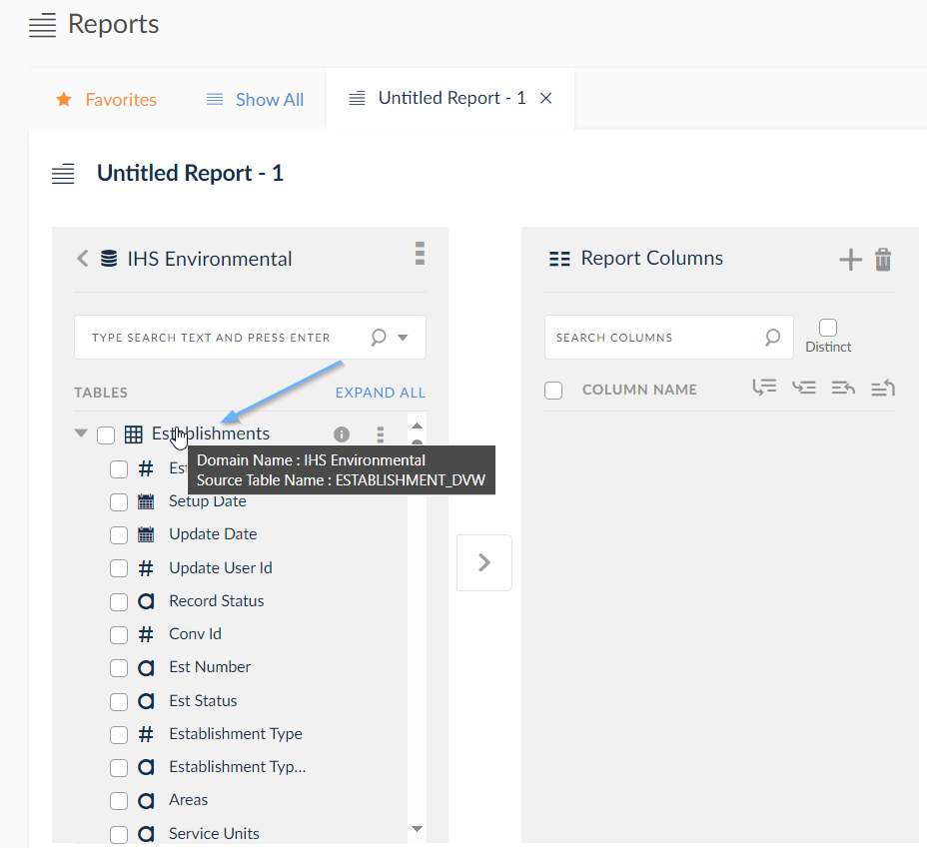
Select the table(s) that contain the items that you want to use in your report. Clicking the arrow to the left of the table will expand the table to show all items contained within the table. Select the “Establishments” table. Click the arrow to the left of “Establishments” to see the items.

Slide 17
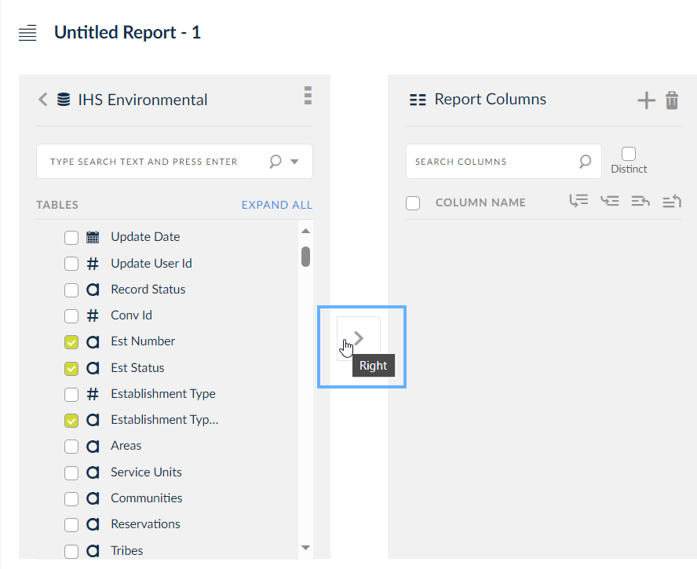
Scroll down the list of items. To select an item check the box to the left of the item(s) and click the (>) sign in between the 2 panes. Let’s select the Est Number, Establishment Type (select the one with a, not the #), Premise Name and Primary Phone. Check the box to the left of these items and click the (>) arrow.

Slide 18
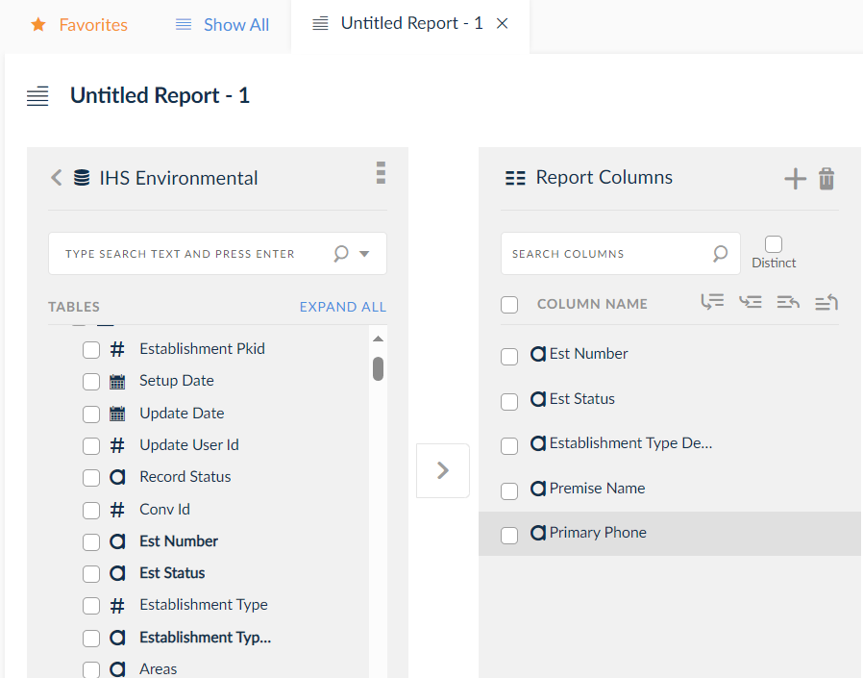
Your screen should now look like this.

Slide 19
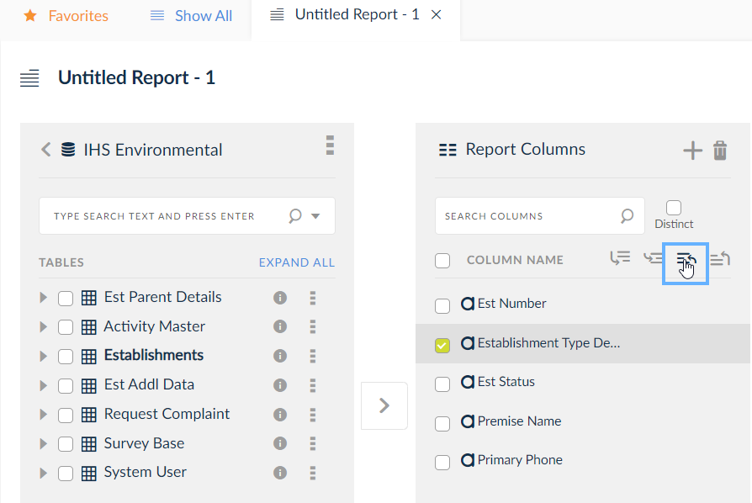
You can re-arrange the order the items appear in the report. To re-arrange the items you will check the box to the left of the column name and click the blue navigation buttons above (top, up, down and bottom).

Slide 20
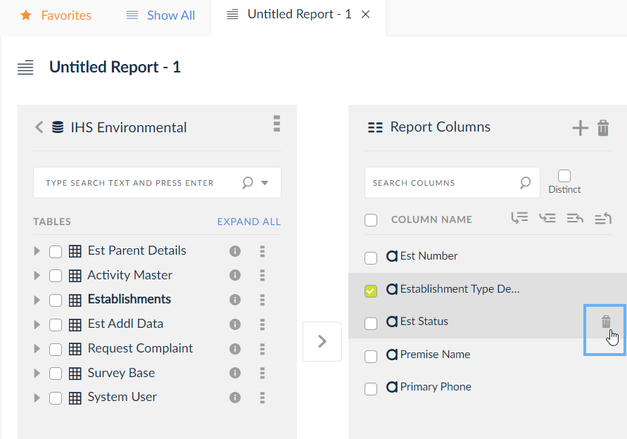
To de-select an item you will click the delete icon (trash can) to the right of the column name.

Slide 21
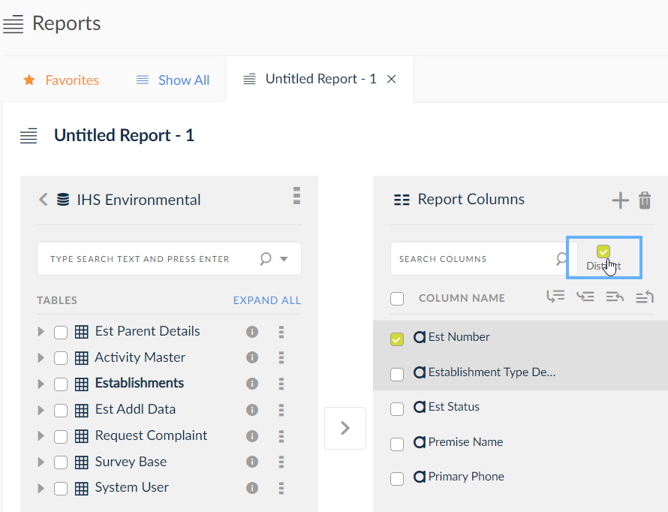
To prevent the duplication of rows check the box next to “Distinct”.

Slide 22
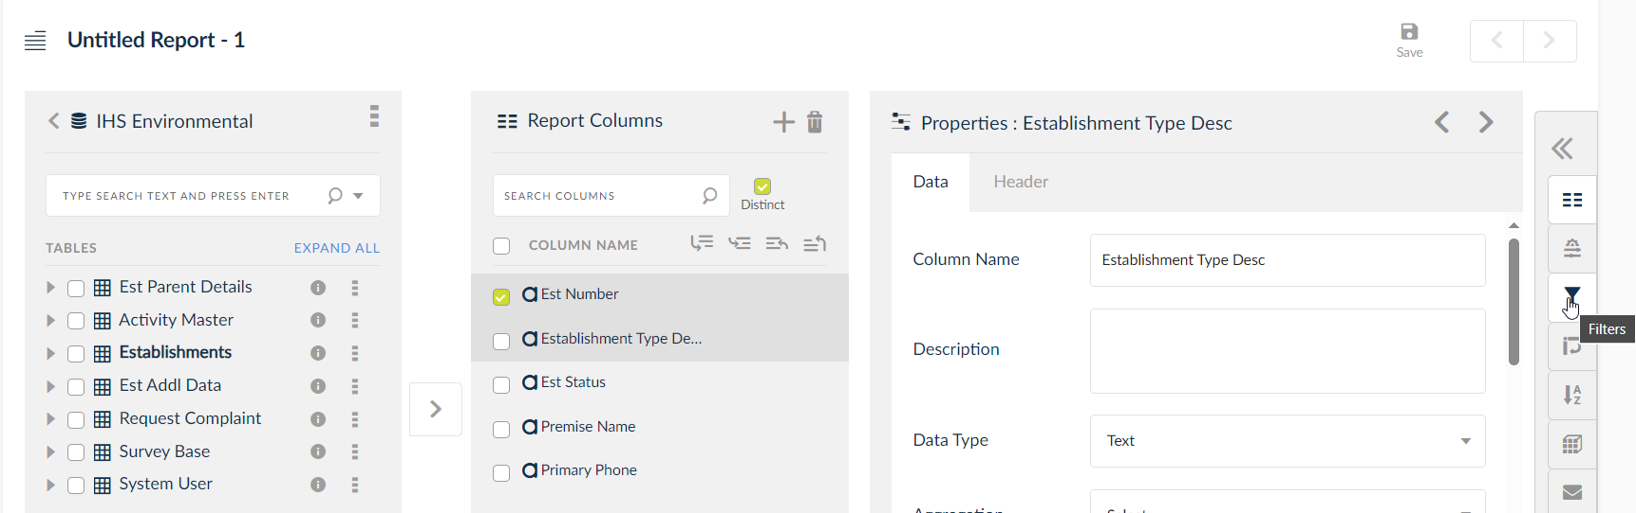
Please click on the icon for “Filters”. We will now create a filter to only see certain establishment types.

Slide 23
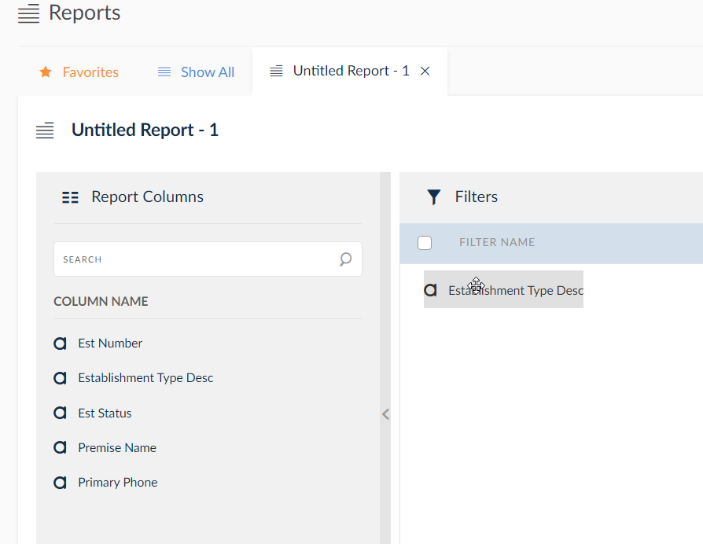
You will need to select the items you want to build the filter on. To do this you will click on the column name and drag it over to the Filters pane. Click on “Establishment Type Desc” and drag it over to the Filters pane.

Slide 24
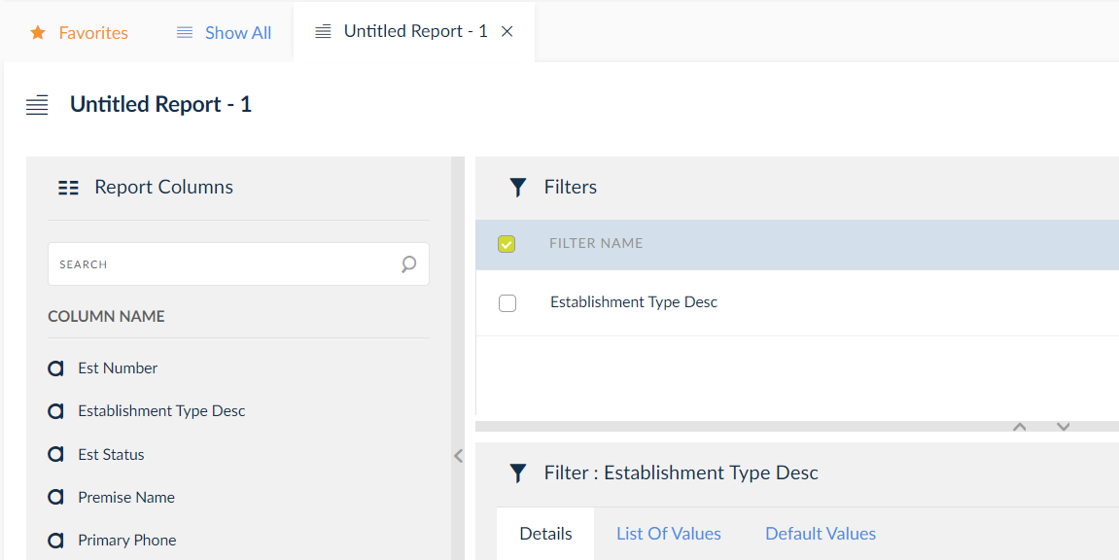
Click the checkbox next to the Filter Name to define your filter.

Slide 25
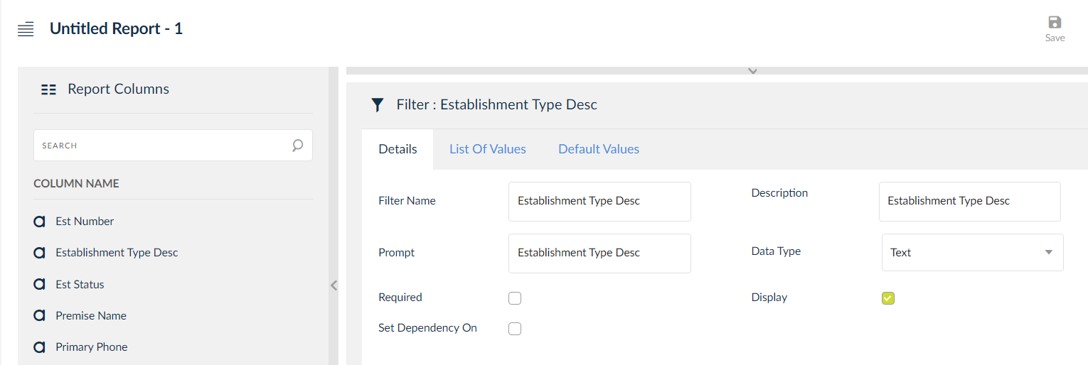
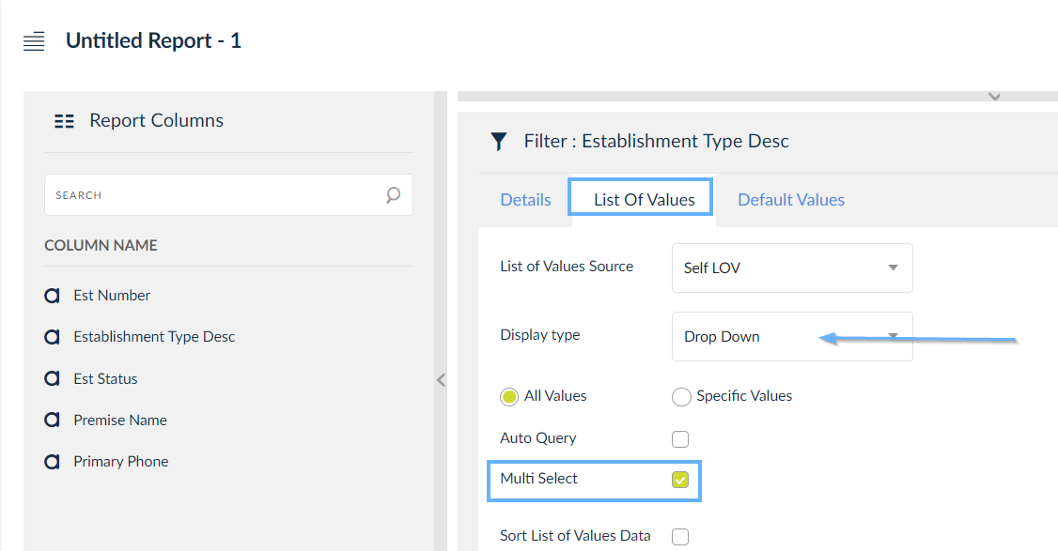
Now you will see the filter options below. The “Details” tab will allow you to define what type of data it is and how it will be entered or selected when running this report. In this case we will make it required (checkbox next to the word Required) and then under the List of Values tab, identify it as a Drop-Down list. We will also allow multiple types to be selected.

Slide 26
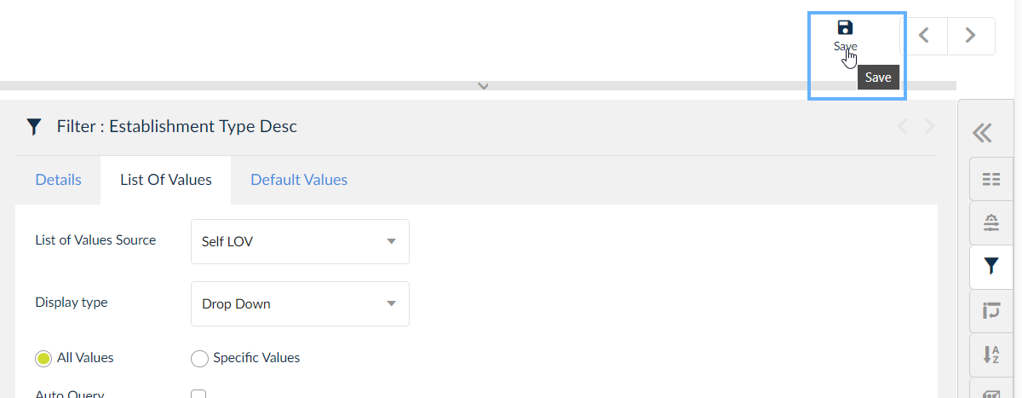
Please save your work by clicking the “Save” icon in the top right hand corner.

Slide 27
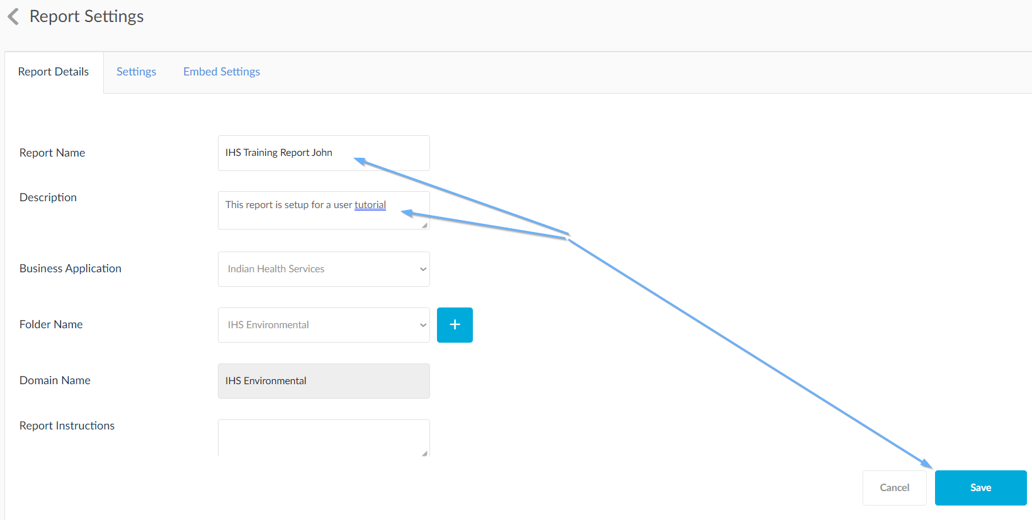
When you first click the Save icon you will be prompted to enter a Report Name. Please enter “IHS Training Report xxxxxxx” where xxxxxxx is your name. Ex: “IHS Training Report John” Click “Save”.

Slide 28
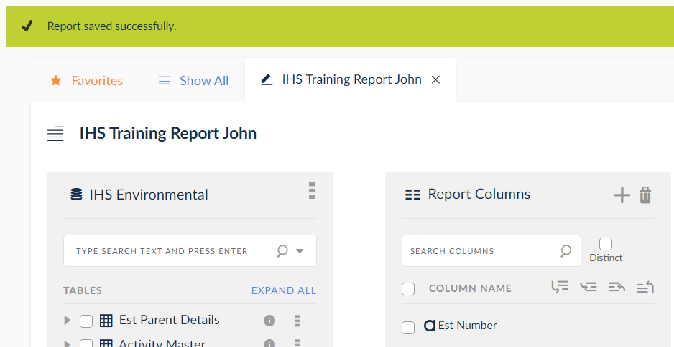
After clicking “Save” you will receive a message letting you know it was saved successfully.

Slide 29
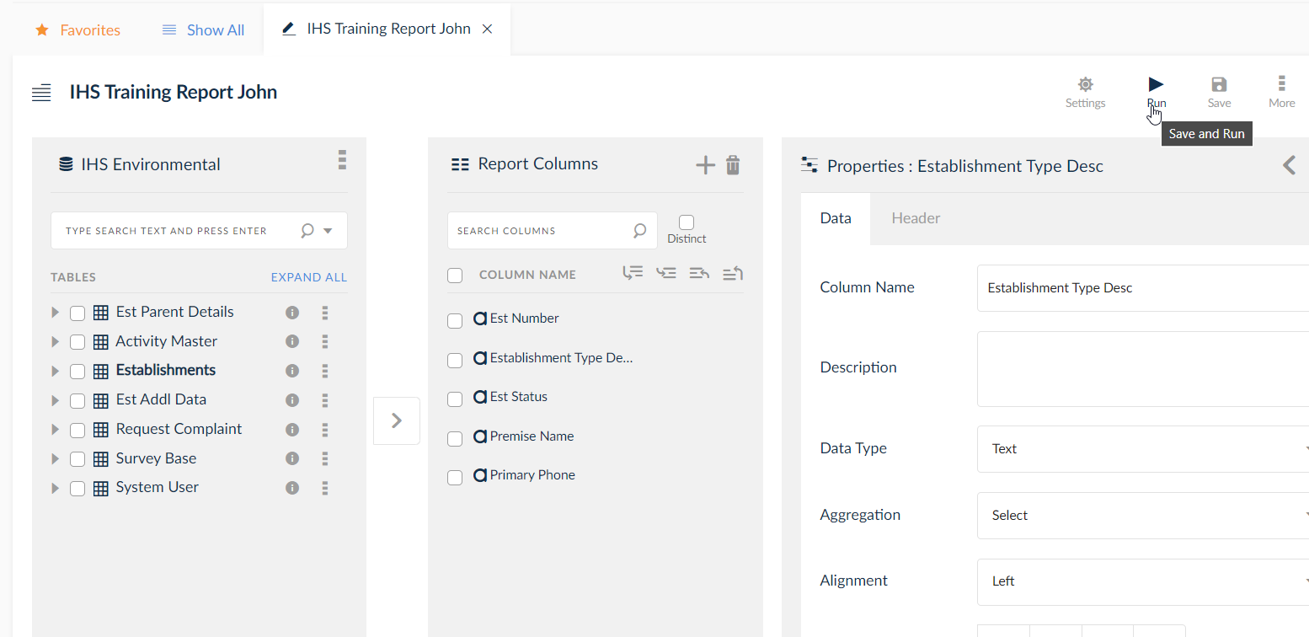
Click the “Run” button.

Slide 30
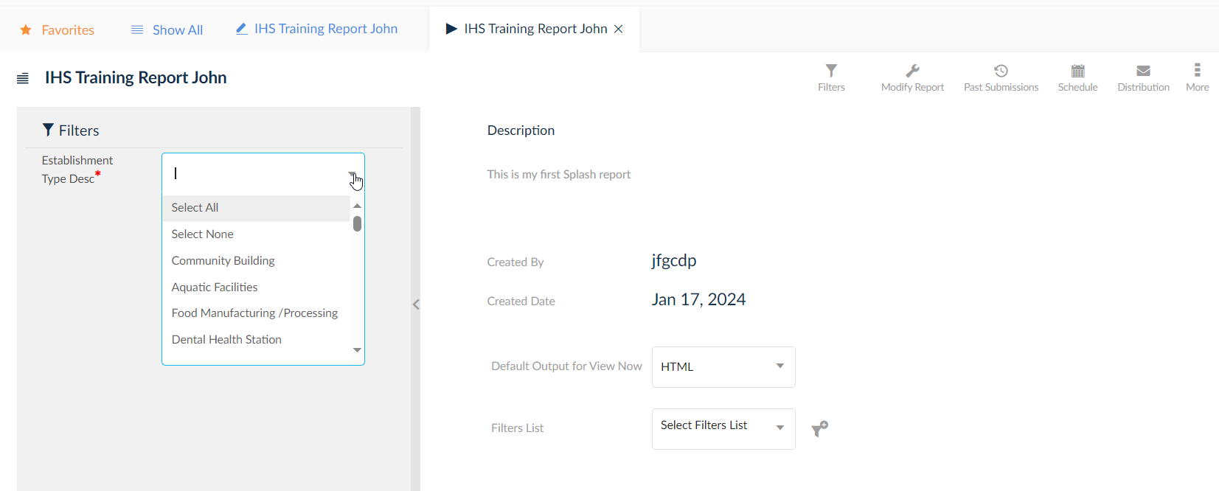
We are now ready to view the report. Notice the drop-down for Est Type.

Slide 31
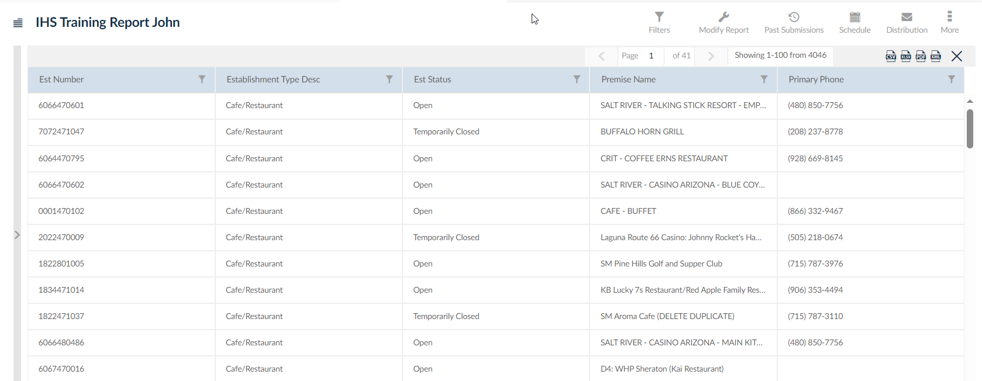
When creating filters, the application will auto-create parameters to choose what you want to see displayed in the report. Since we have a filter created to require at least one establishment type, you will need to select one (or more.) Choose Establishment Type “Café/Restaurant” and click “View Now”.

Slide 32
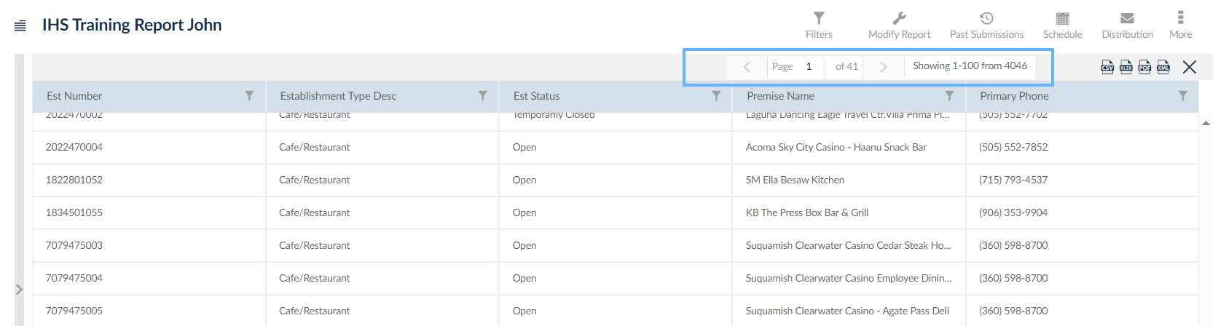
You will now see a list of all Café/Restaurant establishments. Notice at the top that you can navigate between pages, see the total number of pages and see the number of items returned in the report.

Slide 33
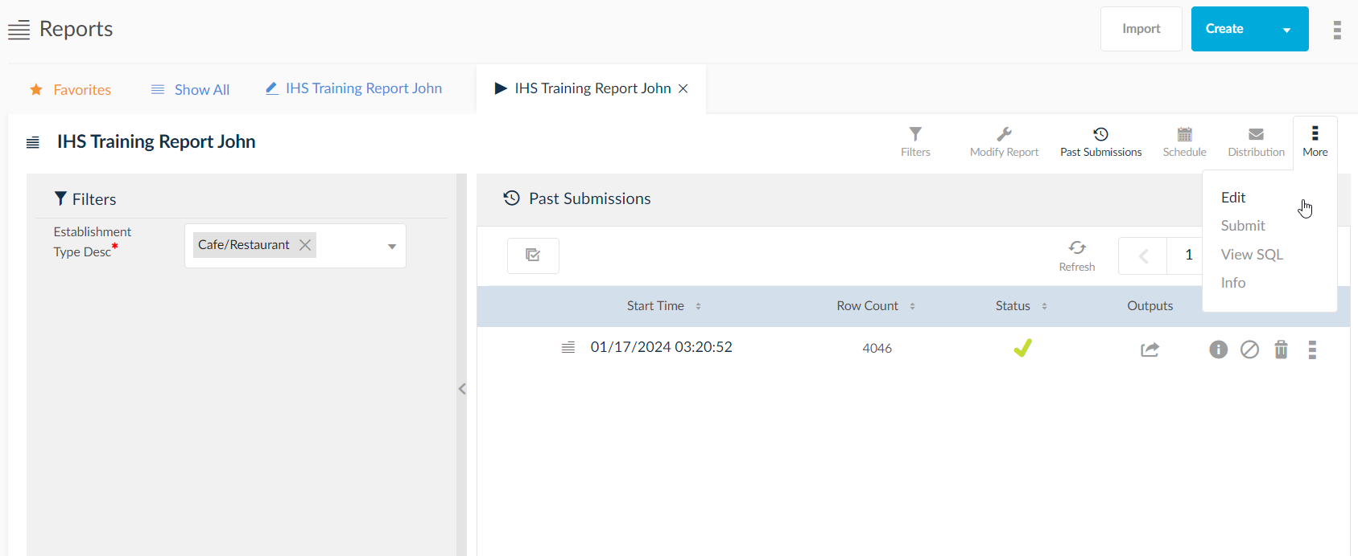
Let’s go in and edit the report. Click the ellipse (3 vertical dots) with More underneath it and select Edit.

Slide 34
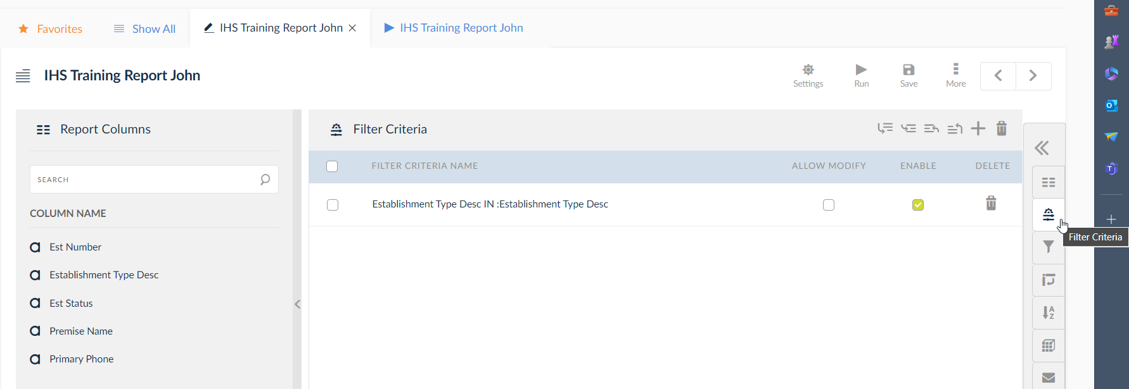
Click on the “Filter Criteria” icon on the right.

Slide 35
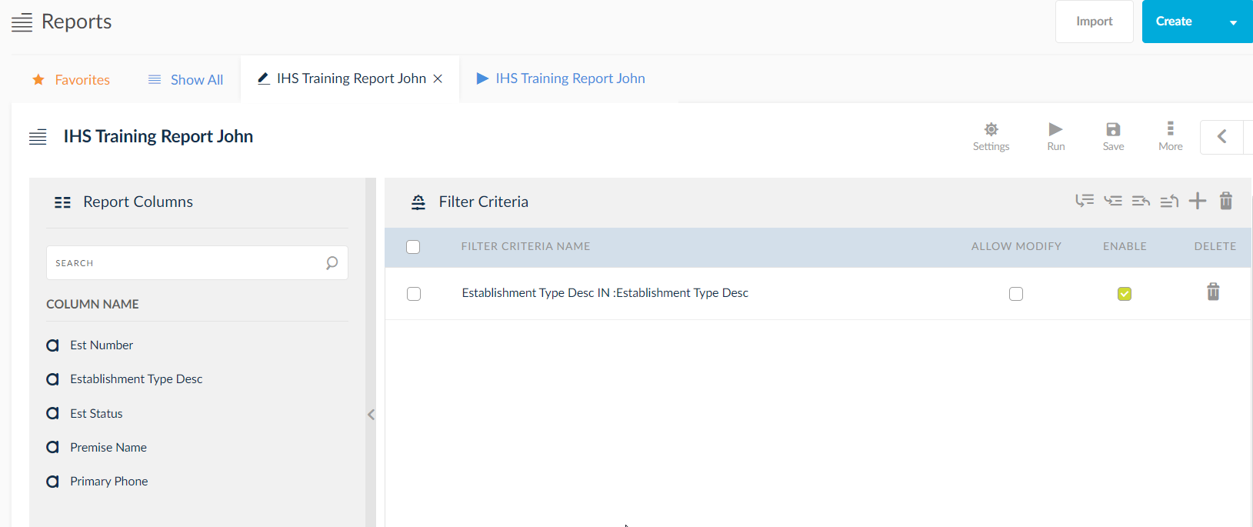
Uncheck the “Enable” option for the Est Type parameter to avoid confusion when running this report.

Slide 36
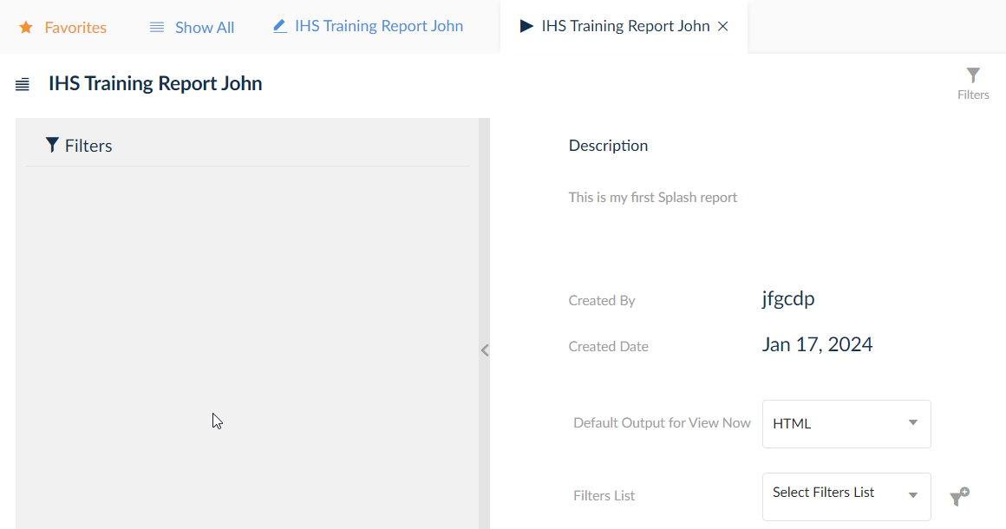
Click the “Save and Run” button.

Slide 37
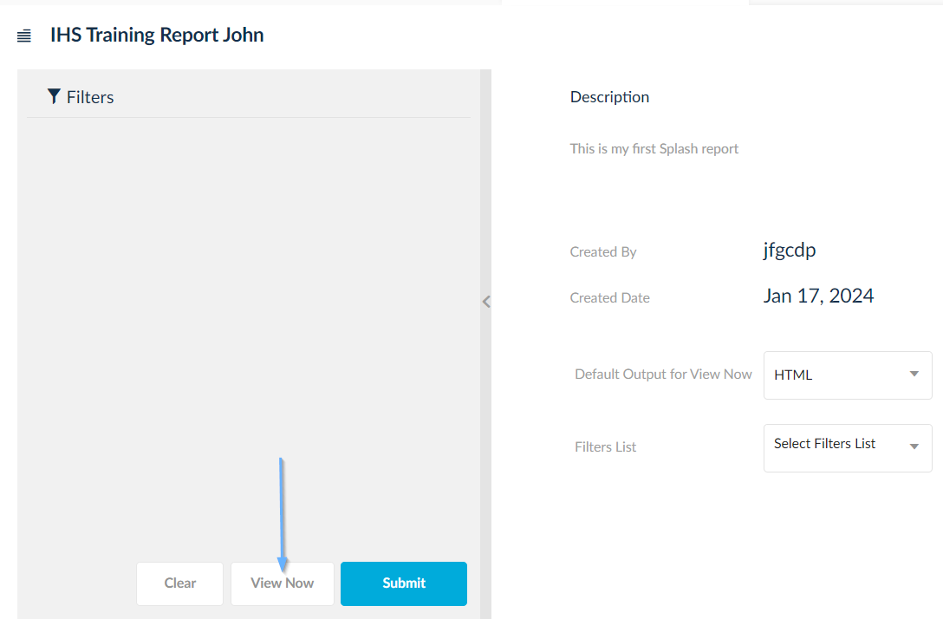
The parameter for Establishment Type is now gone. Click “View Now”.

Slide 38
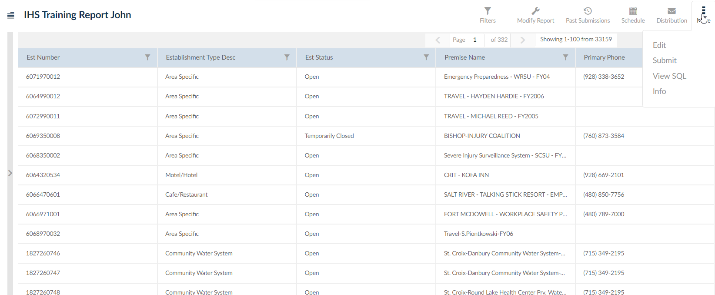
Once the information is displayed click the “Edit Report” icon.

Slide 39
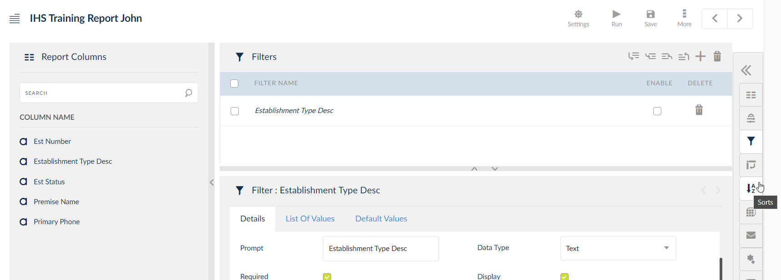
Click the “Sorts” button on the right.

Slide 40
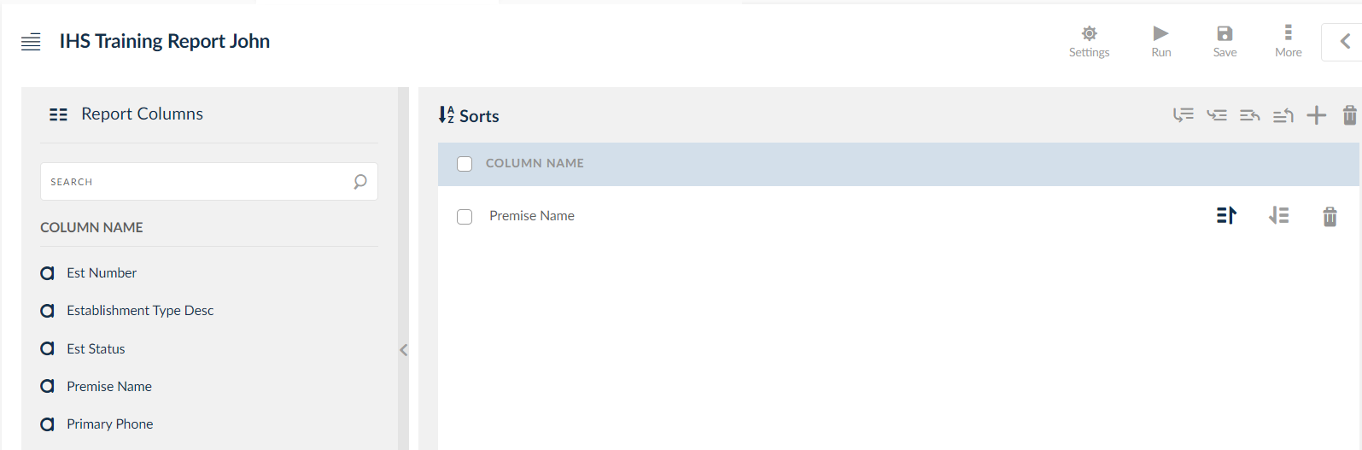
Click on “Premise Name” on the left and drag it to the right under the Sorts column name.

Slide 41
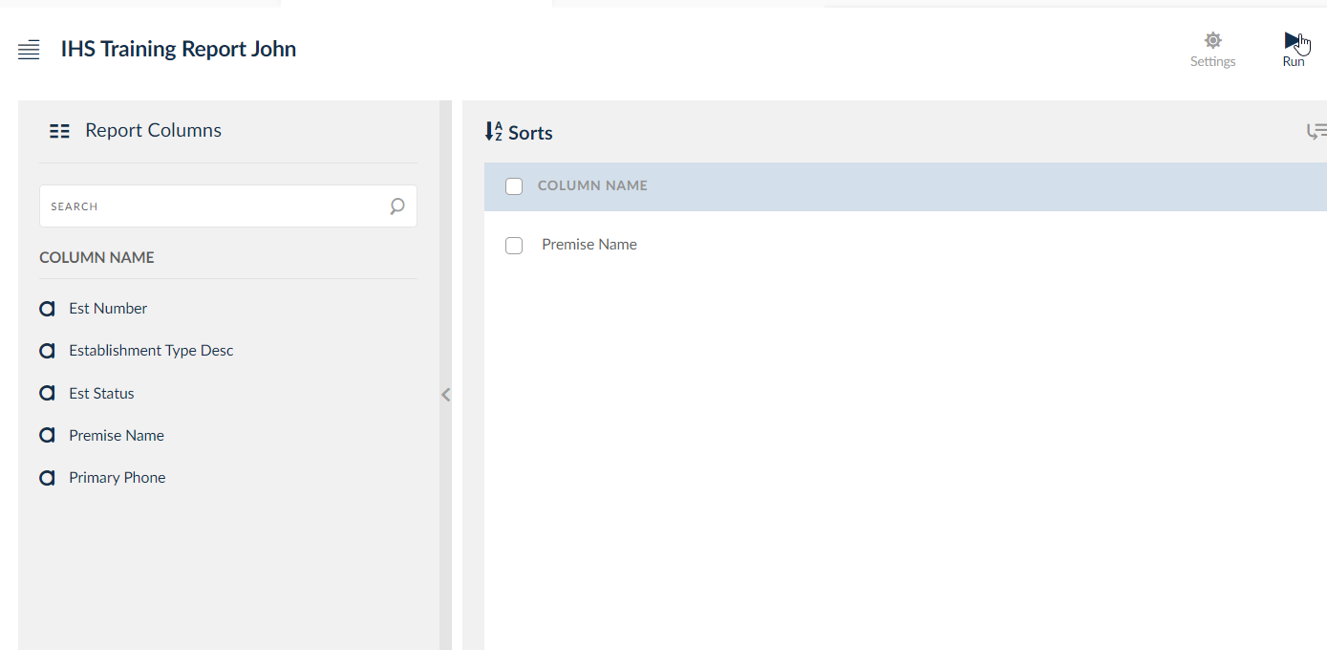
Click “Save and Run”.

Slide 42
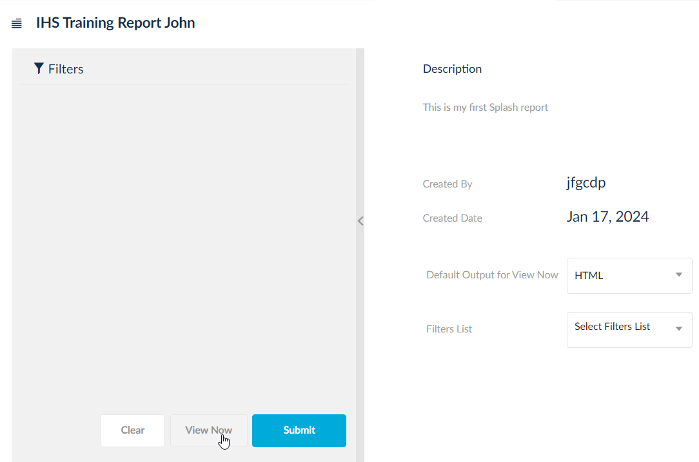
Click “View Now”.

Slide 43
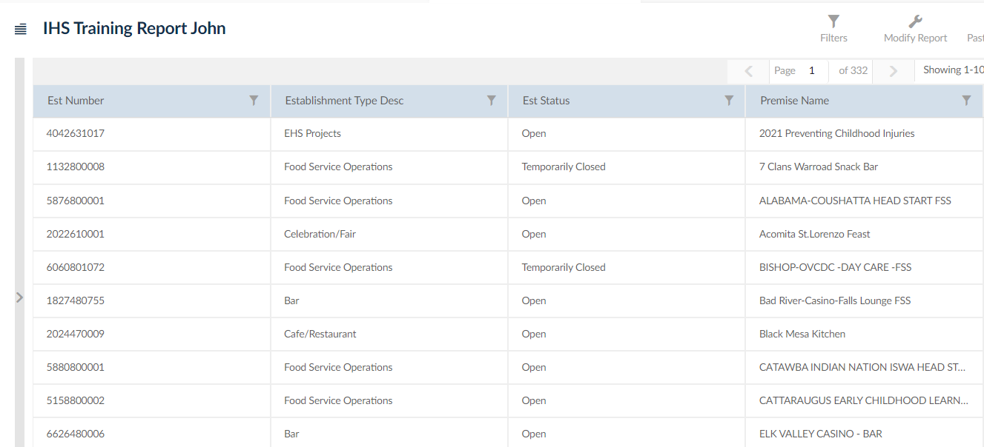
The report is now sorted by Premise Name. Click “Edit Report”.

Slide 44
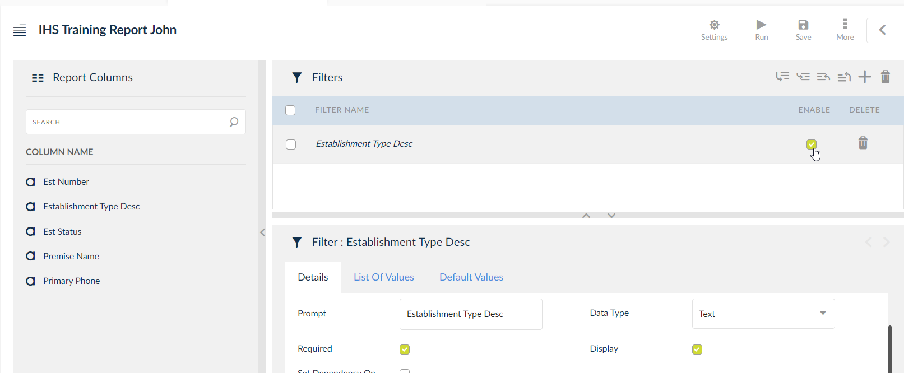
Let’s modify our filter. Click “Filters” and the click “Enable”.

Slide 45
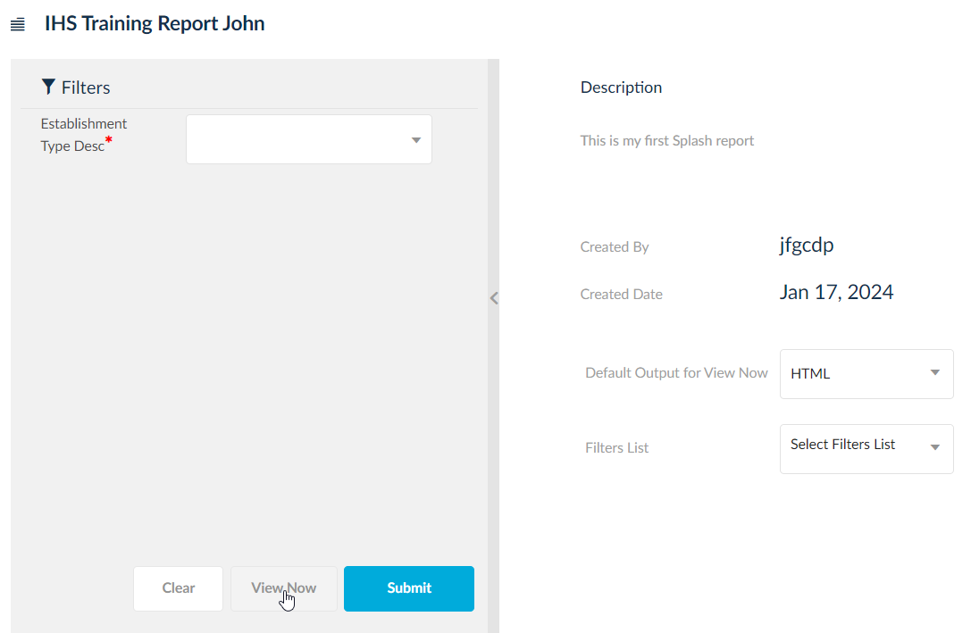
Click “Save and Run” and then “View Now”. Now all Est Types are returned in the report.

Slide 46
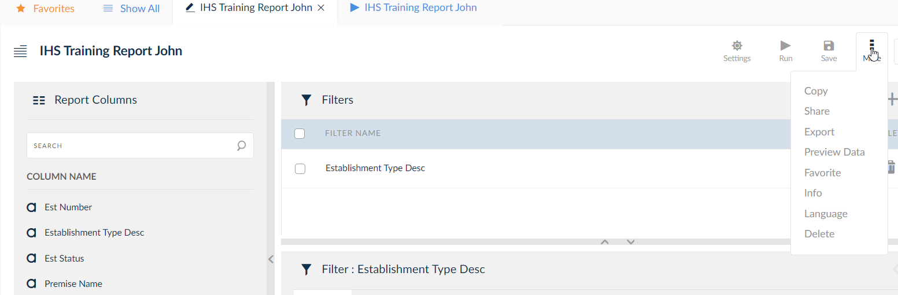
Click “Edit Report”. Edit option is found within the “More”.

Slide 47
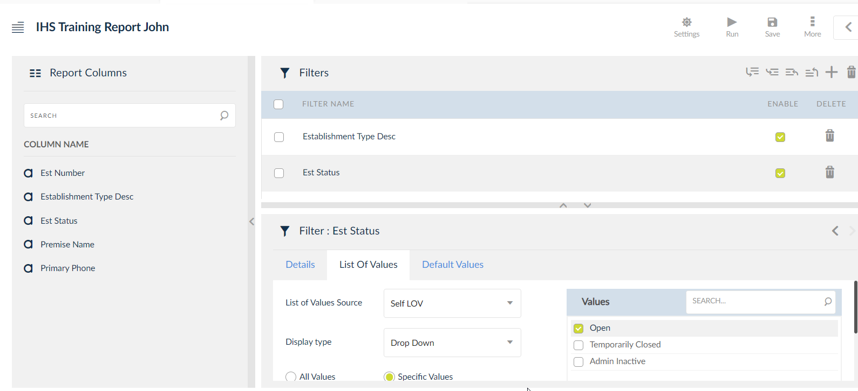
Now add a second filter to the report. Drag Est Status from the left over to the Filters section. On the List of Values tab, select “Specific Values” and then choose from the options provided which ones to include. For this report, select only “Open”.

Slide 48
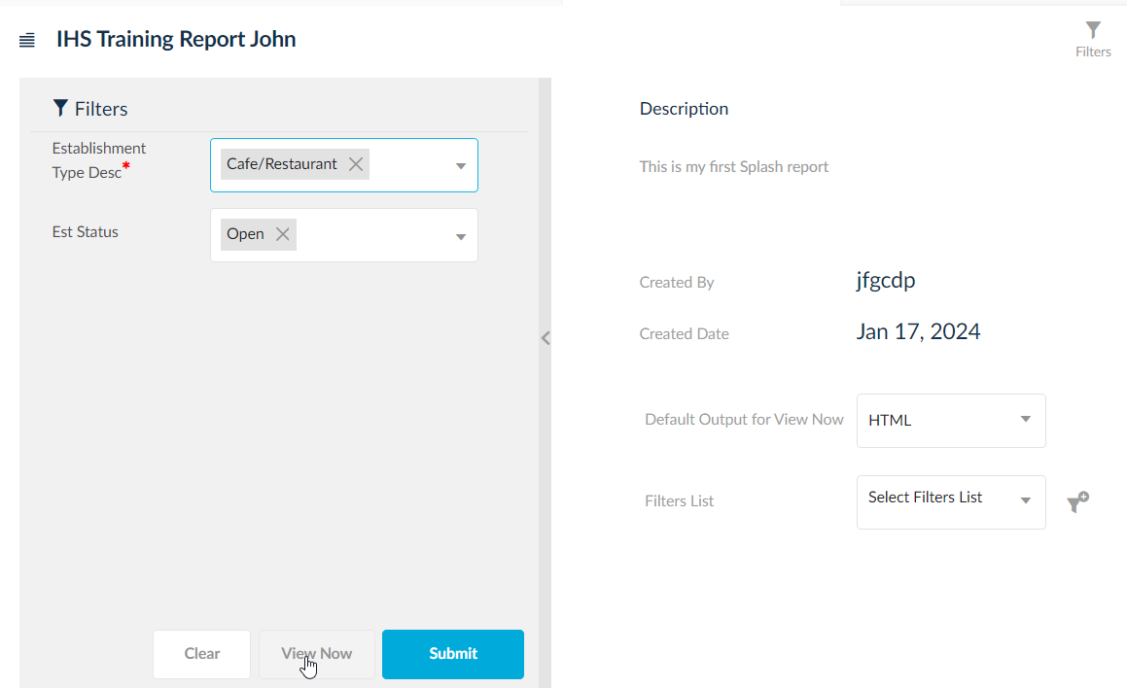
Click “Save and Run” and then “View Now”. You will notice there are now two filters to use, one is required while the other is optional. Select “Café/Restaurant” for Establishment Type Desc and “Open” for Est Status.

Slide 49
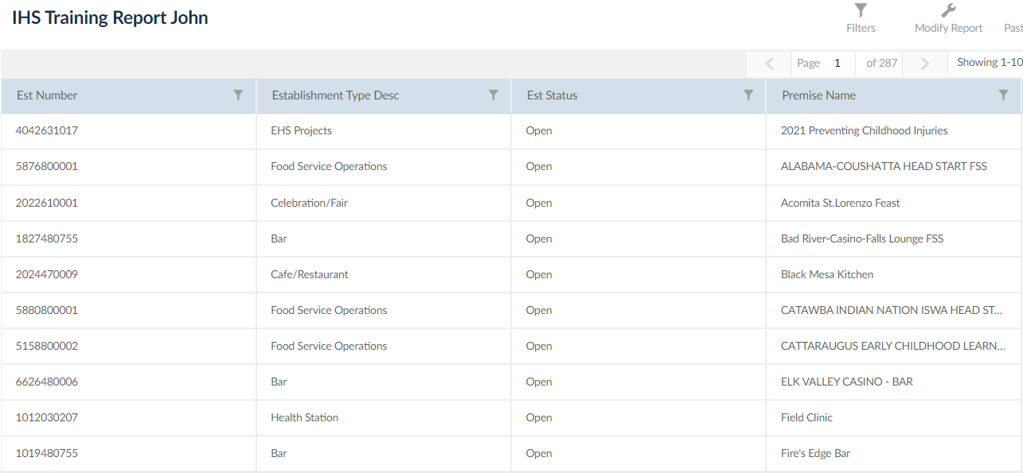
Now you will see all Café/Restaurant types that are in an Open status only in an alphabetic sequence.

Slide 50
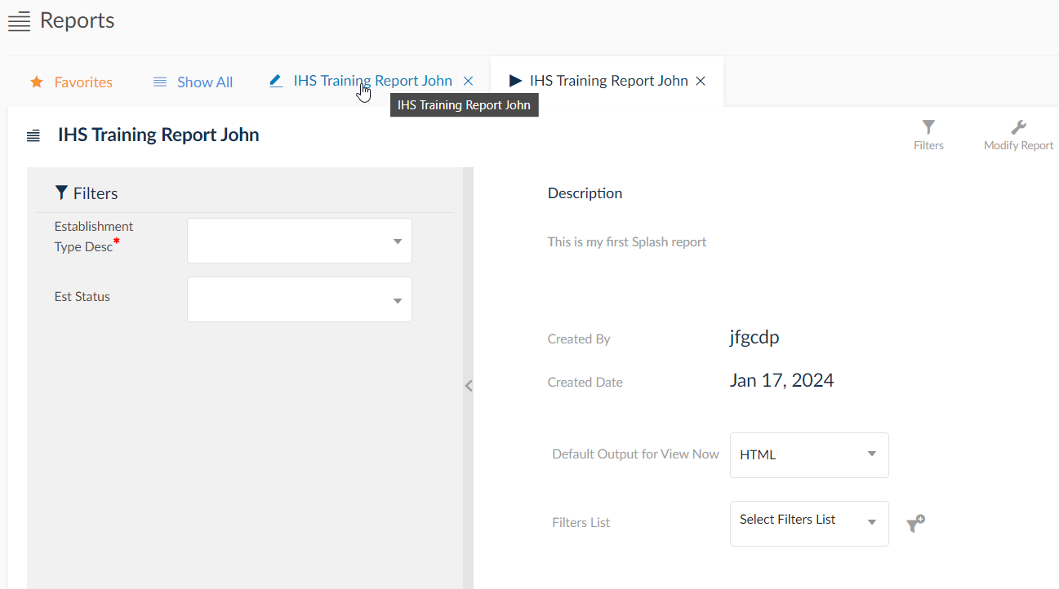
You can also edit your report by clicking the edit tab. Click the edit report tab.

Slide 51
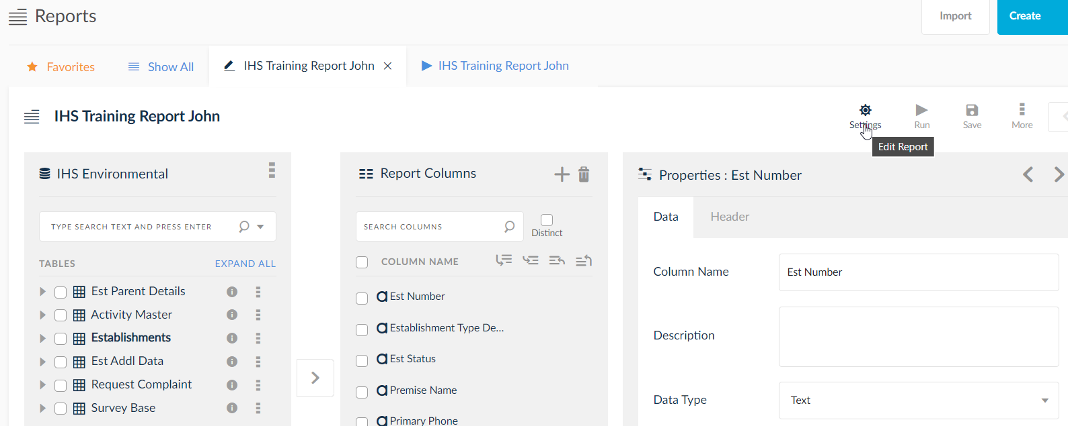
Then click the Settings icon (shaped like a gear) to edit your report.

Slide 52
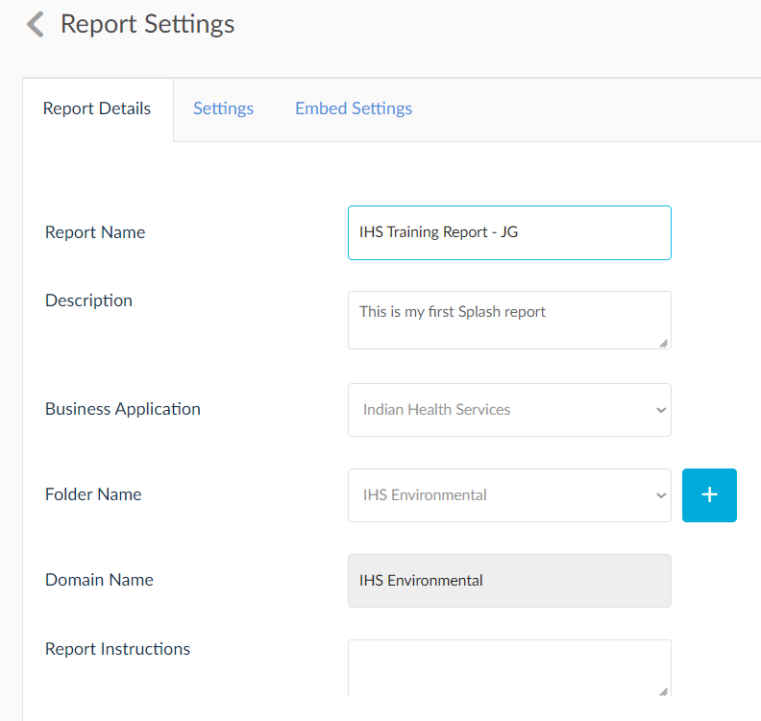
Rename your report to have a dash followed by your initials and Click “Save”. (Ex: IHS Training Report - JG)

Slide 53
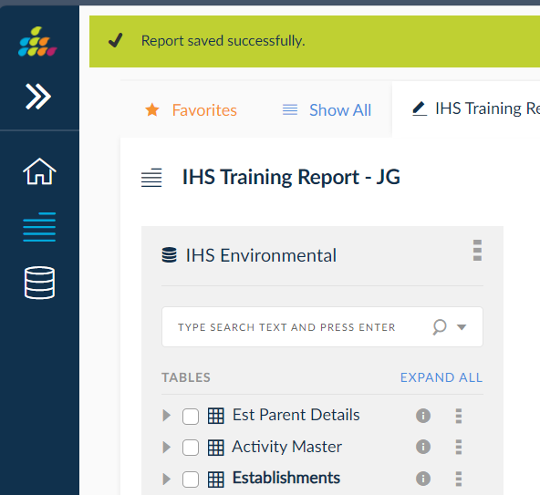
You will receive a message at the top of the page stating report has been saved.

Slide 54
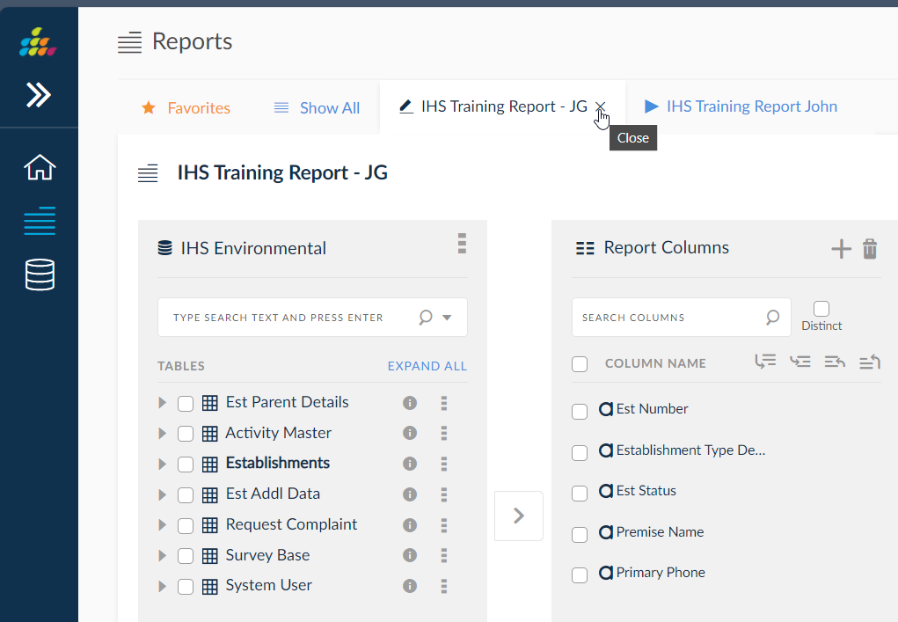
We will close this report. Click the “X” on the view report tab.

Slide 55
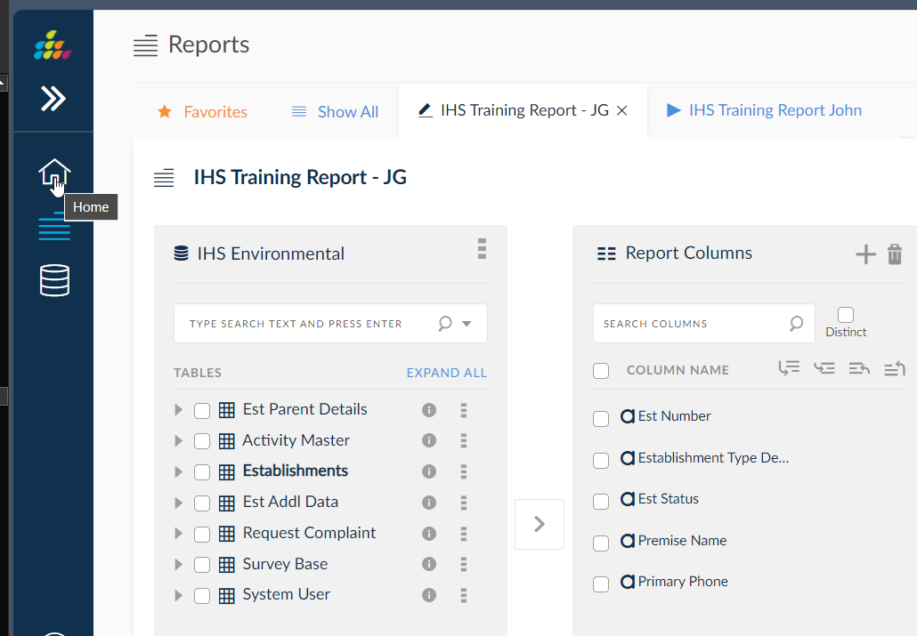
You can click the “X” on the edit report tab or click the “Home” icon on the left. Click the “Home” icon.

Slide 56
What we will do next
Open an existing report
Add an item to the report (from a different table)
Define an aggregation
Edit filters and parameters
Submit a report

Slide 57
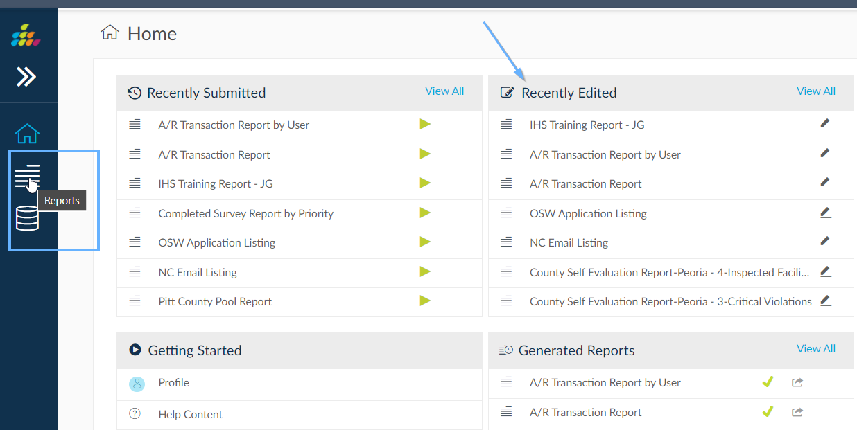
You can probably see your report under “Recently Edited” but we will click on “All Reports” after clicking on the “Reports” icon on the left.

Slide 58
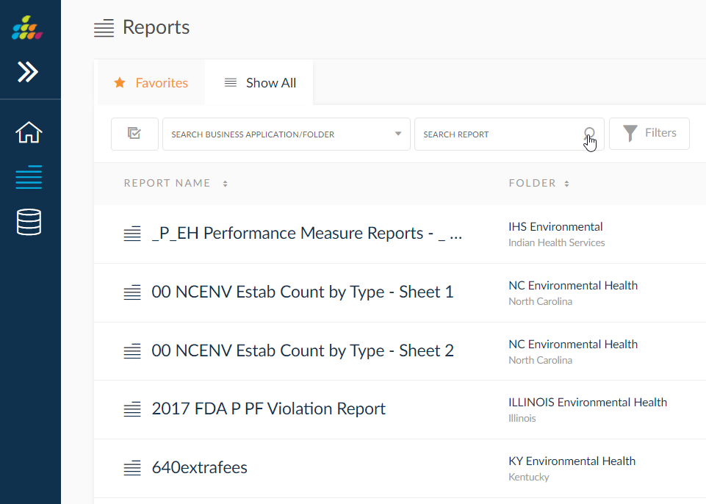
There is a search option available. Manually add your initials in the search area and hit the Enter key on your keyboard.

Slide 59
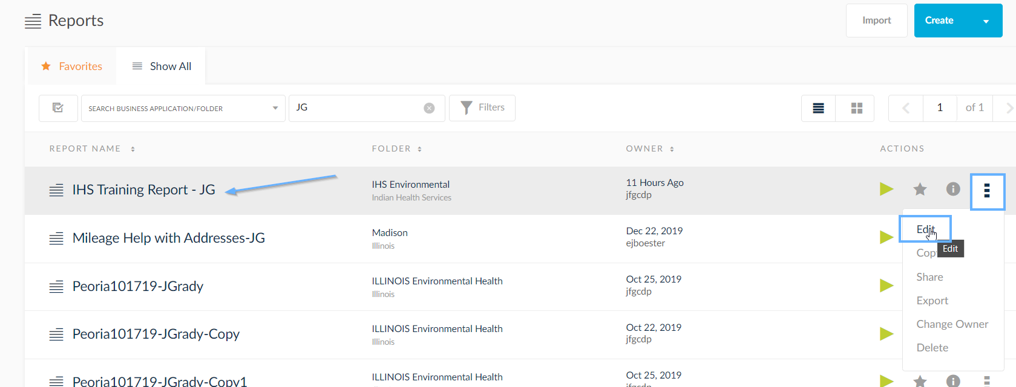
Once you find your report click the elypse (3 vertical dots) in the corresponding row and select “Edit”.

Slide 60
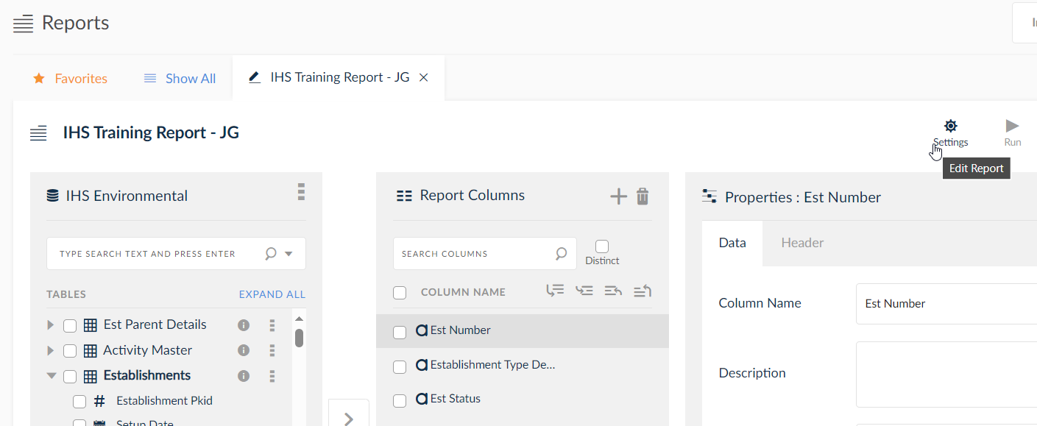
Click the “Settings” icon.

Slide 61

Add a description for your report and click “Save”.

Slide 62

Tables that contain items with no joins to the tables you are currently working with will disappear from the table list. We will now add an item from a different table. Click the arrow next to the Survey Base table.

Slide 63


Check the box next to Survey Date and click the arrow to move that item to the right. Then, click the “Aggregation” icon on the right.

Slide 64

Move “Insp Date” from the Grouped Columns to the Aggregation Columns and choose “Maximum” from the Aggregation drop-down. This will choose the last (or most recent) survey date.

Slide 65

Click the Filters icon and then select Survey date and drag it into the Filters both under Est Status. Next, click the checkbox next to Survey Date.

Slide 66

Check the boxes next to Show Date Range and Show Date Picker under the List of Values tab.

Slide 67

Change Default Value Type to Date Range the Select Start and End date to “Custom” and make the date range start with 01/01/2024 and make the end date today’s date. Click Save and Run.

Slide 68


Click View Now and you will see the last survey for each establishment between those dates. Click the 23 vertical dots and select Edit, then click the report columns button on the right.

Slide 69

Add Survey Type to your Report Columns and click the Filters button.

Slide 70

Add Survey Type to the report filters and then click it under Filter Criteria to be able to edit your new filter.

Slide 71

Choose the filter Survey Type in “Survey Type” and click the Report Columns button.

Slide 72

Disable Survey Type under Properties by unchecking the “Enable” checkbox. This will hide the column in the report (but the filter will still be applied).

Slide 73

Disable the auto-created parameter, click Save & Run. Select “Café/Restaurant” for Establishment Type, “Open” for Est Status, use the default date pre-populated and “FDA 2022 Food Survey” for Survey Type and then View Now.

Slide 74

Now you will see the same report with only establishments that have had a 2022 FDA Food Survey completed during that date range.

Slide 75

Click on edit report tab and then the Report Columns button. We will enable the survey type column to now be included in the report.

Slide 76

Now that the Survey type has been enabled, click Save and Run.

Slide 77

Choose all of the same values for filters we used in the last run and click the “Submit”.

Slide 78

Click the refresh icon until the Status turns to a green checkmark.

Slide 79

Once it is successful click on the output icon and choose to submit to EXCEL.

Slide 80

Your report is now in Excel and can be further modified and printed.

Slide 81
Report #2
We will:
Create a new pivot table report
Define Pivot Items
Add a filter and parameter
Run the report
Save a close the workbook

Slide 82

Please click on “Create Report” from the home page.

Slide 83

From the Survey Base table select the following items: Area, Est id and Survey date, survey type, Survey date Year and Survey date Month.

Slide 84

Make sure your screen looks like this. Save the report as your IHS Training Report 3 followed by your intials. (ex: IHS Training Report 3 - JG), then click Pivots.

Slide 85

Drag Area over to Pivot Filters on the right. Drag Type description under Column Labels and Survey Date Year/Survey Date Month under Row Labels. Lastly drag Est Id under Values and change the Summarized By to Count. Make sure that your screen looks like this and click parameters.

Slide 86

Drag Survey date over to the right under Filters. Make sure the details match these and click the List of Values tab.

Slide 87

Make sure the List of Values match these and click the Default Values tab.

Slide 88

Make sure the Default Values match these and click Save and Run. (A filter was automatically created when we created the parameter. We will leave it enabled.)

Slide 89

Click the drop-down for Insp Date and see all the options available. Leave it set to Custom.

Slide 90

Leave the default values in the date fields and Submit the report. Refresh until it’s successful and choose the EXCEL output for this report.

Slide 91

You may need to click on “Enable Editing” in Excel.

Slide 92

Click on the Report Name tab at the bottom to see your pivot table report. Close out of Excel and click the home button in SplashBI.

Slide 93
Sharing Reports
Sharing a report allows others to view, analyze and print the report. They will only see the data that belongs to them assuming they have the appropriate database privileges.
Anyone that has shared a report with you can also un-share a report. We suggest saving any shared reports as your own if you find them beneficial.
You will lose a shared report from anyone who’s account gets deleted for any reason. We suggest saving any shared reports as your own if you find them beneficial.

Slide 94

To share a report, you will need to open the desired report up in edit mode and click the 3 vertical dots (elypse) icon. In the list of options, select Share.

Slide 95

Choose the person from the Available Users on the left, check the box next to their name and click the arrow pointing towards the right. After clicking “Save”, that user will see that the report has been shared with them.

Slide 96
Please log out of SplashBI.
This concludes our SplashBI 201 training presentation. This should give you enough of a basis to begin creating your own reports.
For a tutorial on signing into and running existing reports in SplashBI, please go through our SplashBI 101 PowerPoint.

Slide 97
Contact CDP’s Customer Support
www.cdpehs.com
ehsupport@cdpehs.com
The email listed above includes the following CDP personnel:
Shelly Cecil
John Grady
Trevor Cannon
866-237-4814

